Slide 1
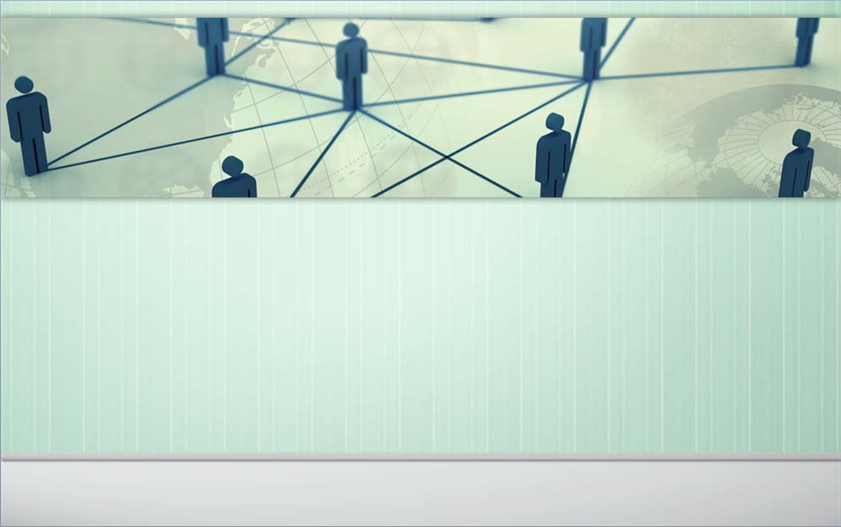
Collaboration networks Analysis
Shuhang Zhou
Social Network Analysis

Slide 2
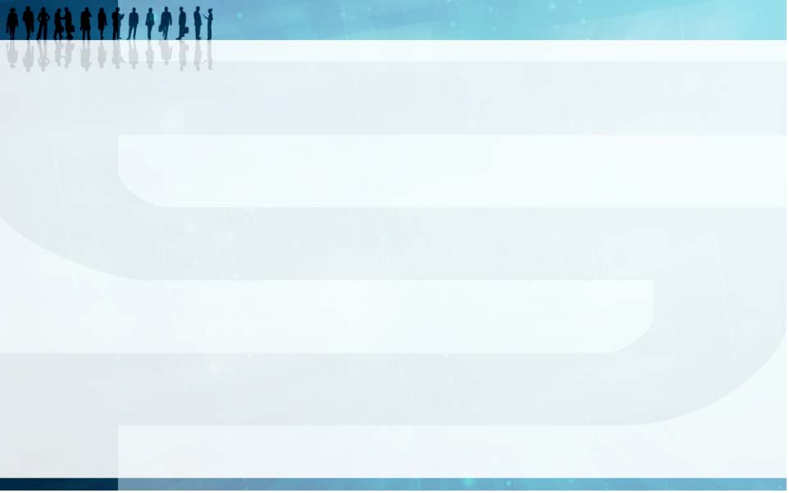
Introduction
With development of technology, the scientist faced more and more difficult problems so that the scientist should work together.
In articles and papers, we can find that there are more and more co-authored papers, and the collaboration group becomes bigger and bigger.

Slide 3
What I want to do
Lotka's law(by A.J.Lotka in 1926)
Num(2 papers)=1/4*Num(1 paper)
Num(3 papers)=1/9*Num(1 paper)
Num(n papers)=1/(2^n)*Num(1 paper)
and Num(1 paper)=60%*TotalNum
The betweenness centrality ,the active person,the VIP
The betweenness centrality can show the importance of nodes in the graph
Active person: who published lots of papers or who coauthored with lots of other authors
VIP: The leader of a group or a community

Slide 4
What I want to do
Community Segmentation
In the coauthor-graph, we can break up it to be some part, each part as a community or a group, find the relationship of the communities and the real world communities(just like in same school and major, or in the same laboratory)
Compare the Chinese and U.S.A collaboration network
Compare and contrast the Chinese and U.S.A collaboration networks, use the graph density,clustering coefficient and some another values to find the same and different between the two area.

Slide 5
Dataset and tool
Dataset from Chinese articles database
Area: General Relativity
Time: 2012
database: Http://www.cnki.net/
Dataset from Stanford Large Network Dataset
Area:General Relativity
Time:1993 to 2003
database:Http://snap.stanford.edu/data/
Tool choose: Gephi

Slide 6
Dataset Treatment
42 articles and 136 authors
Nodes as authors, edges as coauthorship,if a article have n authors that create n*(n-1)/2 edges.
If ignore the weak or strong of the relationship,we can easily get a no weight graph, but the weight of community graph may be really important , so we must create weight of edges, not only the degree, but also the weak or strong of the edges.

Slide 7
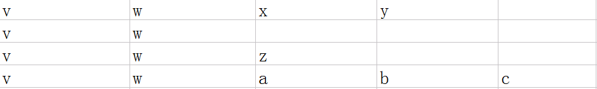
Dataset Treatment
Assume that if v and w coauthored 4 articles
each article has 4,2,3,5 coauthors
so we set the weight(v,w)=
1/3+1/1+1/2+1/4=2.08
As this rule, we can know that the nodes weight degree equals the number of articles this author published

Slide 8
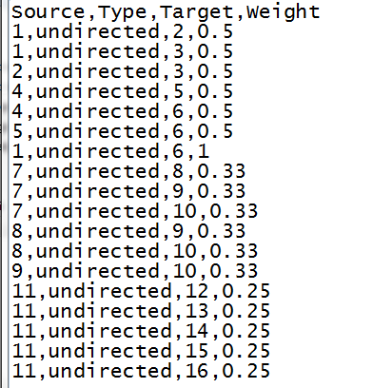
Dataset Treatment
Base on this rule, create a txt input file like this.
There are 409 edges ,but 136 nodes' full graph can have 9180 edges, we can know that this graph is really sparse

Slide 9
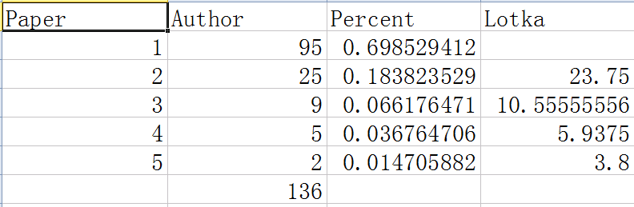
Lotka Rule
To sum up, the dataset is almost obey the Lotka's law, didn't change a lot because the increasement of collaboration.

Slide 10
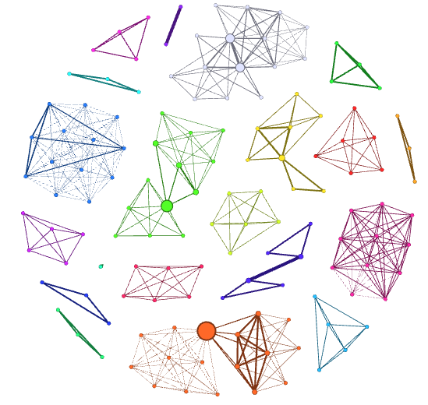
The graph
Fruchterman
Reingold algorithm
Color is base on
modularity(
Community
Segmentation)
Nodes size is based
on the betweenness
centrality

Slide 11
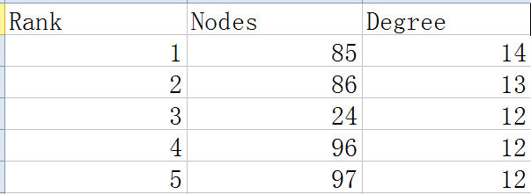
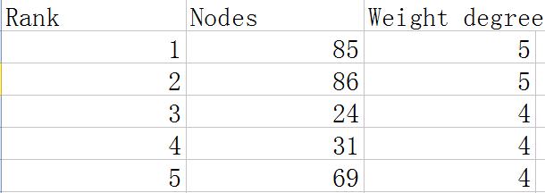
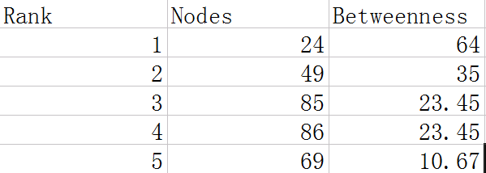
The betweenness centrality ,the active person

Slide 12
The real world informations
Node 24: Department head of USTC
Community: other professors in the major and their doctor student
Node 49: A famous professor of Chinese Academy of Sciences
Community: the group of Chinese Academy of Sciences
Node 85,86: Two professors from two universities
Community: The major of the two universities(include professors and student)

Slide 13
Stage Summary
We can find that the active person and the betweenness centrality can almost show that which one is the leader of a science community, at least is the VIP in the community.
We can find that the Community Segmentation almost show that the real world community

Slide 14
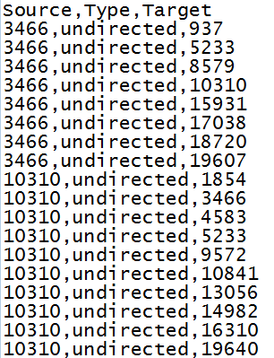
The input of USA
download from http://snap.stanford.edu/data/ca-GrQc.html
It has 5242 nodes and 28980 edges,we can know that it is a really sparse graph.
The dataset just have the relationship between authors , have no the weight of links

Slide 15
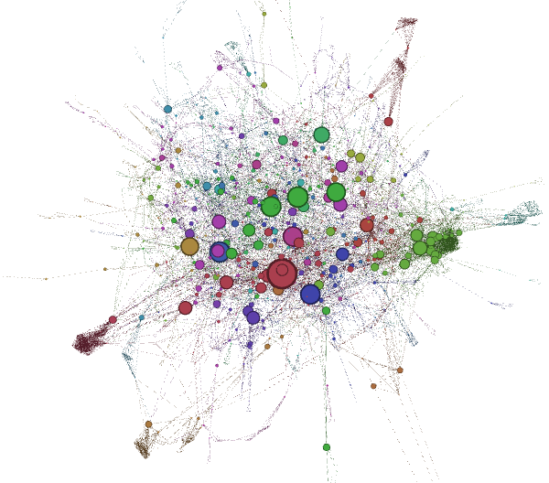
The graph of U.S.A
The color is based
on modularity but
because of the large
input we cannot do
segmentation really
well.

Slide 16
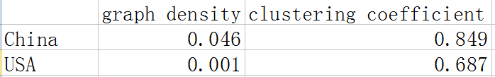
Compare and Contrast
Cluster Analysis
base on these we can find that the cluster effect in the collaboration networks is really notable, that means the authors always work in their own community , they didn't do many communication with other communities. On one hand, it is not good for development of technology, on the other hand, it can protect the patent right.

Slide 17
Conclusion
The collaboration networks still obey the Lotka's law
The betweenness centrality can help us find the active persons and the important person(like leader) in the community
The Community Segmentation can help us to find the real world groups or the cooperation of two groups.
The clustering coefficient shows that the USA groups have more communication with other groups , but still not really much, each group almost just communicate in their own space.

Slide 18
Reference
Http://www.cnki.net/
Http://snap.stanford.edu/data/
Liu X M, Bollen J, Nelson M L, et al. Co- authorship networks in the digital library research community
Liu Jun, Introduction to Social Network Analysis
Http://www.udemy.com/gephi/
Alfred J. Lotka, Lotka's law,
http://en.wikipedia.org/wiki/Lotka%27s_law
BURKS R L,CHUMCHAL M M.To co-author or not to co-author:how to write,publish,and negotiate issues of authorship with undergraduate research students.

Slide 19
THANKS FOR WATCHING

